Slide 1

2 Week Work Experience Presentation

Slide 2
A Bit About Me
About to go into my final year of an integrated masters physics course at Warwick – where my final project involves dealing with large amounts of data captured by telescopes looking at exploding stars
Want to work in data science after I graduate since I enjoy programming, data analysis and have a huge passion for AI and evolving technology
Before the work experience, I had lots of coding experience but only with physics and maths related application.
The OCR project James gave me has given me the chance to learn a whole new side of coding, especially since I’ve never used LLMs in code before.

Slide 3
What I’ve Done and Learnt
Main Project: Using LLMs to classify and extract useful information out of different types of documents used by the bank e.g. bank statements, payslips etc.
Further work on project to make the model more agentic – get LLM to do code instead of my machine or use function calling with gpt model.
Had a play around with public datasets to use supervised and unsupervised ML algorithms
Been involved in several calls and meetings – shown me the more managerial side of things and how so many more skills than coding itself is required by a data scientist, especially in applied fields like banking.
Daily calls with different members in the team, seen actual coding and demonstration for models currently being used. Learnt about how RAG models work, agentic AI and exposure to sands and cloud computing as well through AWS, SQL queries and even learnt how different financial models work e.g. mortgage predictions, churn models etc.

Slide 4
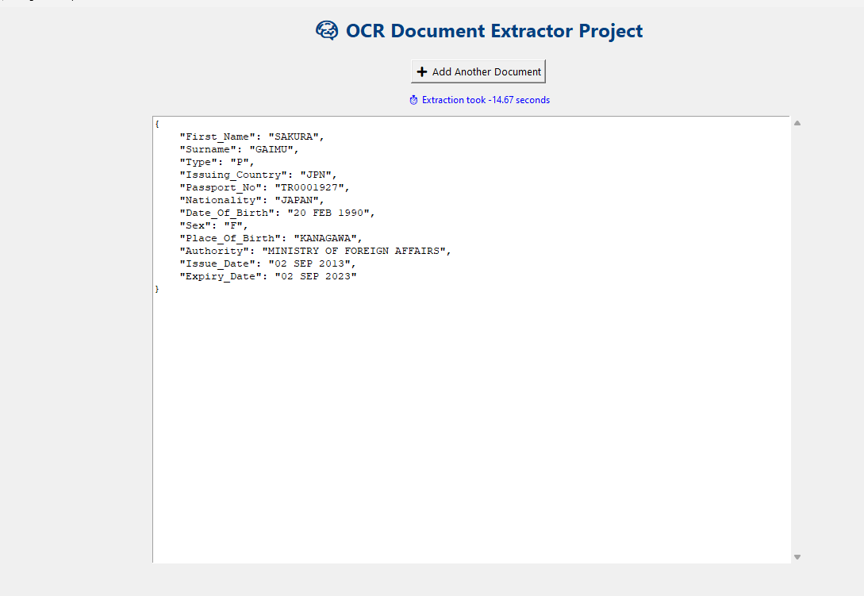
OCR Extraction Project
Used LLM to decide document type from given list and a failsafe if it wasn’t a supported document.
Then using selection based on the first prompt answer, a second prompt specific to the document type was fed to LLM which then successfully outputted required details in JSON dictionary
To automate and minimise user interaction, I set up a UI which you can drag and drop files into and then the dictionary is outputted
I used tkinter for the UI and threading so that live updates could be displayed while extraction occurred.
Gave two examples of each document and model accurately read all of them

Slide 5
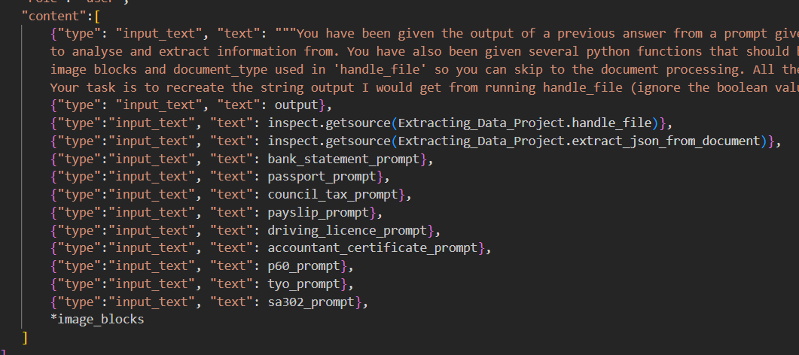
Taking it Further
I tried to do the same task using two other methods
Passing the functions as string to LLM and getting LLM to do all the logic and run through code
Use openai function calling so LLM does deciding document code for me

Slide 6
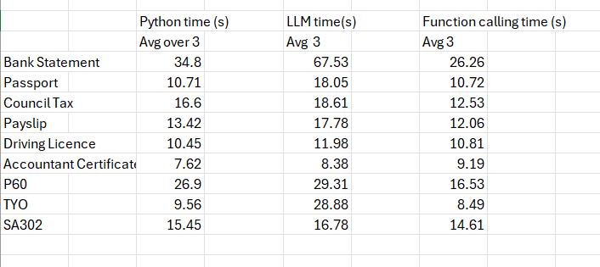
What I Found
On average the quickest extraction was from API function calling and slowest was LLM doing all logic, especially for complex documents
For simpler docs times very similar
SA302 complex document but all 3 models did very similar time

Slide 7
Further Work After Experience
Build my github for job application with work project and the agents research I did
Do some research and attempt to build my own RAG model
Read up more on traditional machine learning algorithms and attempt to program my own too
Kaggle!

Slide 8

Thank You For Listening!

